Slide 1
Testing Types
Software Testing

Slide 2
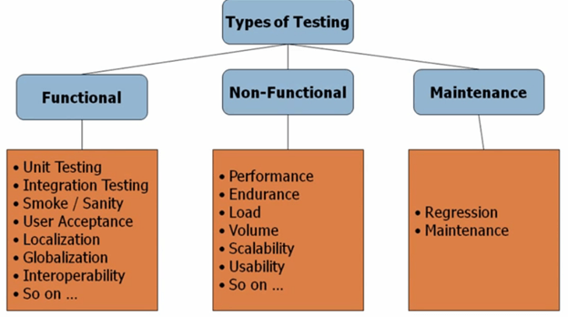
Types of testing

Slide 3
Functional Testing types
Unit Testing
Unit testing, a testing technique using which individual modules are tested to determine if there are any issues by the developer himself. It is concerned with functional correctness of the standalone modules.

Slide 4
Functional Testing types
Unit Testing - Advantages:
Reduces Defects in the Newly developed features or reduces bugs when changing the existing functionality.
Reduces Cost of Testing as defects are captured in very early phase.
Improves design and allows better refactoring of code.
Unit Tests, when integrated with build gives the quality of the build as well.

Slide 5
Unit Testing Techniques:
Black Box Testing - Using which the user interface, input and output are tested.
White Box Testing - used to test each one of those functions behavior is tested.
Gray Box Testing - Used to execute tests, risks and assessment methods.

Slide 6
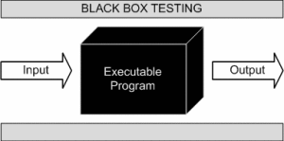
Black Box Testing -
Also known as Behavioral Testing,
It is a software testing method in which the internal structure/design/implementation of the item being tested is not known to the tester.

Slide 7
Black Box Testing -
We don't look at technical working of an application
No need of programming skills
Tests from users perspective
Input and outputs are checked against expected output

Slide 8
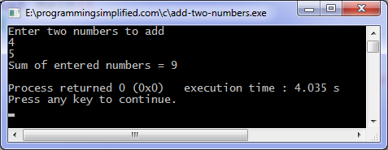
Example

Slide 9
Black Box Testing Methods
Graph Based
Equivalence partitioning
Boundary value Analysis
Orthogonal Arrays

Slide 10
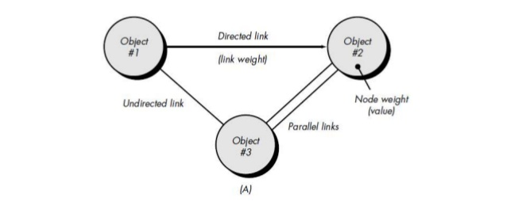
Graph Based
It is similar to a decision-based test case design approach where the relationship between links and input cases are considered.

Slide 11
Equivalence partitioning
This test case designing techniques checks the input and output by dividing the input into equivalent classes.
The data must be tested at least once to ensure maximum test coverage of data.
It is the exhaustive form of testing, which also reduces the redundancy of inputs.
Finding valid and invalid states
Applicable for specific value ,range of values and boolean

Slide 12
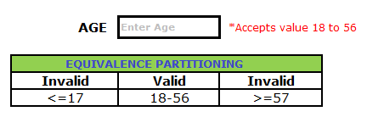
Example

Slide 13
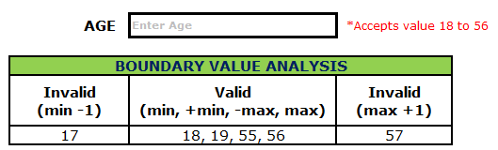
Boundary value Analysis
It is the widely used black-box testing, which is also the basis for equivalence testing.
Boundary value analysis tests the software with test cases with extreme values of test data.
BVA-Boundary value analysis

Slide 14
Orthogonal Arrays
Type of software testing strategy that uses Orthogonal Arrays especially when the system to be tested has huge data inputs.
For example, when a train ticket has to be verified, the factors such as - the number of passengers, ticket number, seat numbers, and the train numbers has to be tested, which becomes difficult when a tester verifies input one by one. Hence, it will be more efficient when he combines more inputs together and does testing

Slide 15
White box Testing
Defined as the testing of a software solution's internal structure, design, and coding.
Also known as clears box testing, Transparent testing and glass box testing.
Applied on all levels of SDLC
Tests are based on code structure and conditions
All logical decisions , loops, and internal data structures of code are verified

Slide 16
White box testing-techniques
Basis Path Testing
Control Structure Testing

Slide 17
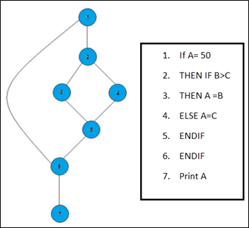
Basis Path Testing
We can see there are few conditional statements that is executed depending on what condition it suffice.
Here there are 3 paths or condition that need to be tested to get the output
Path 1: 1,2,3,5,6, 7
Path 2: 1,2,4,5,6, 7
Path 3: 1, 6, 7

Slide 18
Steps for Basis Path testing
The basic steps involved in basis path testing include
Draw a control graph (to determine different program paths)
Calculate Cyclomatic complexity (metrics to determine the number of independent paths)
Find a basis set of paths
Generate test cases to exercise each path

Slide 19
Control Structure Testing
Control structure testing is a group of white-box testing methods.
Branch Testing(each branch must execute once)
Condition Testing( Errors in conditions due to Boolean and relations data types)
Data Flow Testing(use of variable according to location)
Loop Testing(all types of loops tested )

Slide 20
Integration testing
INTEGRATION TESTING is a level of software testing where individual units are combined and tested as a group.
The purpose of this level of testing is to expose faults in the interaction between integrated units.
Test drivers and test stubs are used to assist in Integration Testing.

Slide 21
Integration testing techniques
Big Bang is an approach to Integration Testing where all or most of the units are combined together and tested at one go. This approach is taken when the testing team receives the entire software in a bundle. So what is the difference between Big Bang Integration Testing and System Testing? Well, the former tests only the interactions between the units while the latter tests the entire system.

Slide 22
Integration testing techniques
Top Down is an approach to Integration Testing where top-level units are tested first and lower level units are tested step by step after that.
Bottom Up is an approach to Integration Testing where bottom level units are tested first and upper-level units step by step after that. This approach is taken when bottom-up development approach is followed. Test Drivers are needed to simulate higher level units which may not be available during the initial phases.
Sandwich/Hybrid is an approach to Integration Testing which is a combination of Top Down and Bottom Up approaches.
Stubs are used which are temporary modules if a module is not ready for integration testing we replace that module with stubs until it get ready
Stub is a called program and driver is a calling program

Slide 23
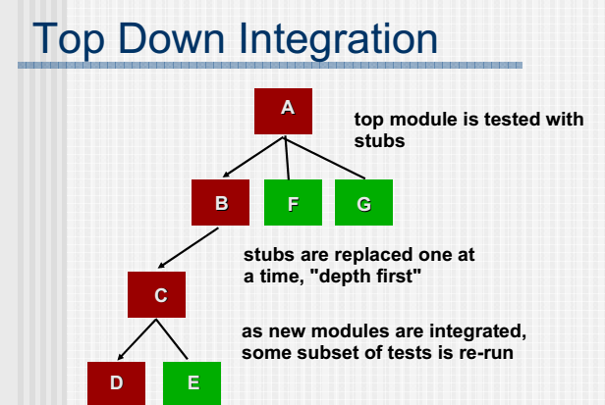
Top-Down Integration

Slide 24
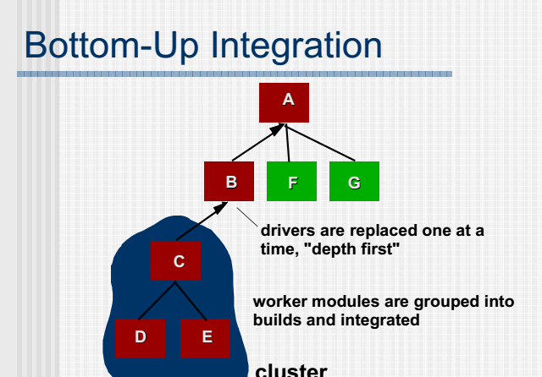
Bottom-Up

Slide 25
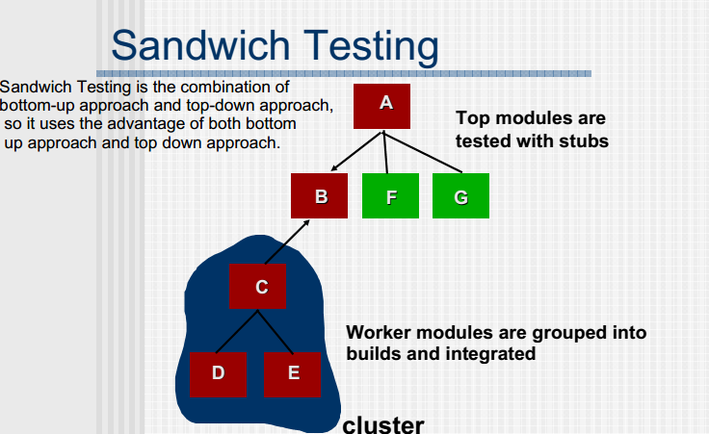
Sandwich Testing

Slide 26
Grey box testing
GRAY BOX TESTING is a software testing method which is a combination of Black Box Testing method and White BoxTesting method.
Grey box testing is when the tester has a partial understanding of the internal structure in the system under test.
Grey box testing is a process for debugging software applications by making an input through the front-end, and verifying the data on the back-end.

Slide 27
Gray-box testing Techniques:
Regression testing
Pattern Testing
Orthogonal array testing
Matrix testing
Grey-box testing is a perfect fit for Web-based applications.
Grey-box testing is also a best approach for functional or domain testing.

Slide 28
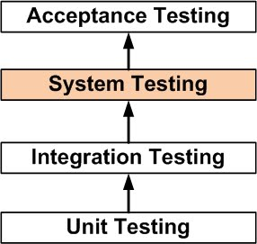
System testing
SYSTEM TESTING is a level of software testing where a complete and integrated software is tested.
The purpose of this test is to evaluate the system’s compliance with the specified requirements.

Slide 29
System testing
It may include tests based on risks and/or requirements specification, business processes, use cases, or other high level descriptions of system behavior, interactions with the operating system, and system resources.
System testing is most often the final test on behalf of development to verify that the system to be delivered meets the specification and its purpose may be to find as many defects as possible
Most often it is carried out by specialist testers that form a dedicated, and sometimes inde-pendent, test team within development, reporting to the development manager or project manager.
System testing should investigate both functional and non-functional requirements of the system.

Slide 30
Acceptance testing
When the development organization has performed its system test and has corrected all or most defects, the system will be delivered to the user or customer for acceptance testing.
Can the system be released?
Acceptance testing is most often the responsibility of the user or customer
The goal of acceptance testing is to establish confidence in the system, part of the system or specific non-functional characteristics, e.g. usability, of the system.
Acceptance testing is most often focused on a validation type of testing, whereby we are trying to determine whether the system is fit for purpose

Slide 31
Alpha & Beta Testing
Alpha Testing normally takes place in the development environment and is usually done by internal staff.
The important thing here is that it takes place in the development environment.
Based on the feedback – collected from the alpha testers – development teams then fix certain issues and improve the usability of the product.
Beta Testing, also known as “field testing”, takes place in the customer’s environment and involves some extensive testing by a group of customers who use the system in their environment.
These beta testers then provide feedback, which in turn leads to improvements of the product.

Slide 32
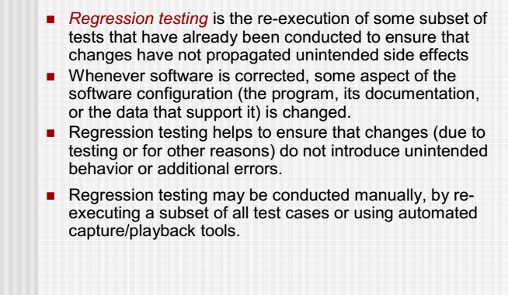
Regression testing

